Slide 1
HACKATHON 3.0
Wednesday April 4, 2018
The Dina Wind Power of Art Hackathon sponsored by the Wind Foundation

Slide 2

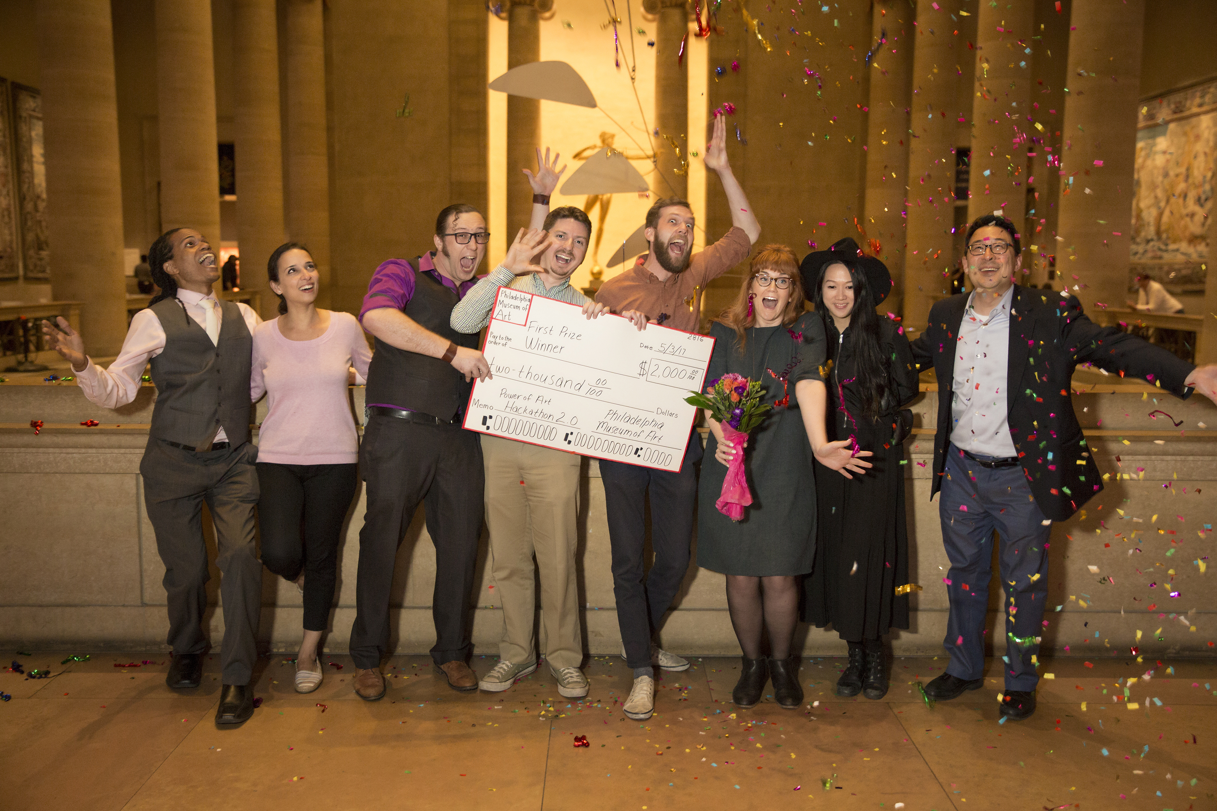
Welcome
…to our
third annual HACKATHON !!
Vibes – Hackathon 2.0 winners

Slide 3
Welcome
Why Do We Do This?
Community
Ideas
Fun

Slide 4

Judges
Andrew Cameron Zahn
Founder, CRUXspace
New Media Artist
Cloud Shop Studios
CRUXspace is Philadelphia’s only New Media Art Gallery.

Slide 5
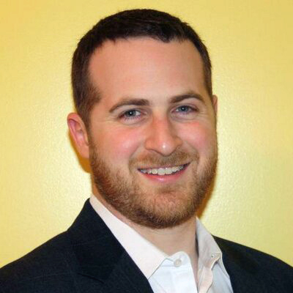
Judges
Brett Topche
Co-founder, Red & Blue Ventures
Brett is a seed-stage investor in technology and technology-enabled companies from the University of Pennsylvania ecosystem and has a decade and a half of venture capital and private equity experience.

Slide 6
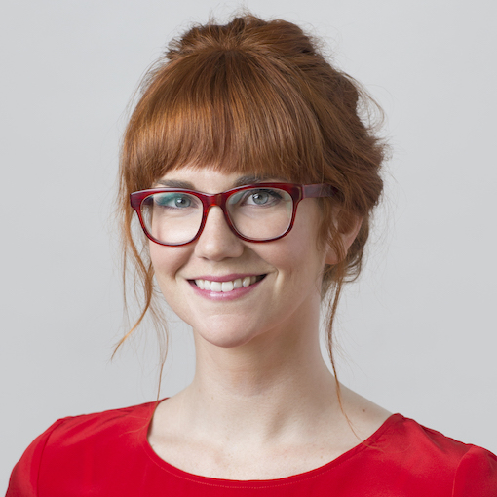
Judges
Corinne Warnshuis
Executive Director, Girl Develop It
Girl Develop It is a nonprofit organization that exists to provide opportunities for women to learn web and software development.
Third year as a judge!!

Slide 7
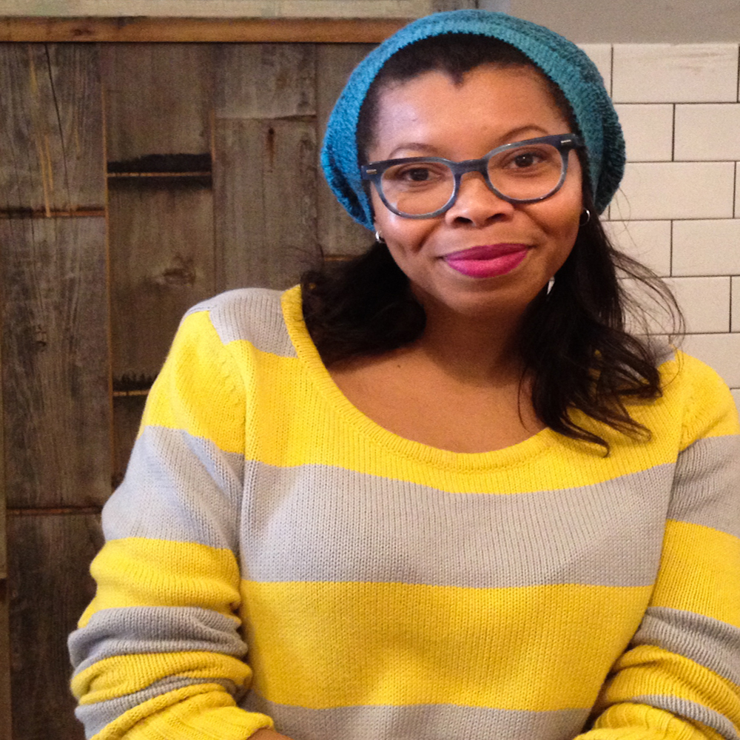
Judges
Ginger Rudolph
Founder & Editor of HAHA Mag (High on Art, Heavy on Antics)
Co-founder/web content writer HAHAxParadigm
HAHAxParadigm is a Philadelphia based initiative that curates and produces engaging public art projects.

Slide 8
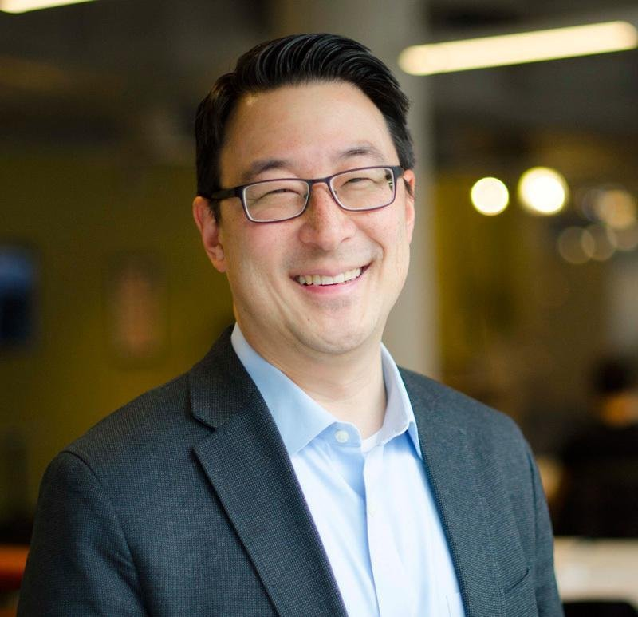
Judges
Youngmoo Kim
Director, Expressive and Creative Interaction Technologies (ExCITe) Center & Professor of Electrical and Computer Engineering, Drexel University
Third year as a judge!!

Slide 9
Prizes
$ 2,000
People’s Choice Award
$ 500
You also get a Membership!
Grand Prize

Slide 10
Prompt
The Problem:
Typically, art museum visitors arrive wondering where to start their visit and how to find objects they like. Once they find an object they like, visitors want to understand it and find their connection to it.

Slide 11
Prompt
The Challenge:
Use the Museum’s Hackathon resources and gather crowd-contributed data to create a game or guide that leads visitors to discover objects in an entertaining and engaging way. Your solution should grow with repeated use by employing techniques such as machine learning, recommendation systems, and/or crowd-sourcing.

Slide 12
Judging
Criteria:
Technical Difficulty
Originality
Polish
Usefulness
Engagement

Slide 13

Events
Hackathon Kickoff Wednesday, April 4, 6:30 p.m.
Hacklabs Wednesdays, April 11, 18 & 25; May 2 & 9
Preliminary Judging Wednesday, May 16, 6 p.m.
Closing Event — Final Friday: Hack the Museum Friday, May 25, 5:00–8:45 p.m.
April 11th HACKLAB:
Presentation on Collections Data!!
Presentation on API and Wayfinding Resources!!

Slide 14
Rules
Requirements:
Team members must purchase a Hackathon registration in order to be eligible to win.
To submit a project to the Philadelphia Museum of Art Hackathon on DevPost, you’ll be asked for your Order Confirmation number from your registration order.
Teams must have two to six members. One person teams are not allowed. You may bring your team or form one at the kickoff.
Register your team on DevPost as soon as you can. You must do it by May 9th.
Bring your own laptop. We’ll provide work tables at the Hacklabs.
Use the Museum dataset and wayfinding tools given at Kickoff, April 4.

Slide 15
Rules
Deliverables:
Due May 9, 10 p.m.: Submit a video (maximum 2 minutes) that demonstrates the app in use. Do not make a promotional-style sales pitch. Do include stills and/or video screen grab captures. Write a description of the app for DevPost and choose a main image to represent your project.
Due May 9, 10 p.m.: Submit source code of your app to your GitHub account and send us a link to it.
May 16, 6:00-8:00 p.m.: At least two team members must be present to represent you at Preliminary Judging. You will have 5 minutes to answer the judge's questions about your submission.
May 25, 6:00-7:00 p.m.: Finalist teams must demonstrate their app in two different galleries for Final Judging.
May 25, 6:00-7:00 p.m.: Runner Up teams can compete for the People's Choice Award by demonstrating their apps in the Great Stair Hall.

Slide 16
Rules
Packet:
Hackathon Badge
Code of Conduct
Photography Guidelines
Prompt with Judging Criteria
Gallery List and Map

Slide 17
Help
PMA Team:
Claire | Jasmine | Brian
Emily | Morgan
Danielle | Ann
Jessica | Ariel
Bill | Susan
Guyda | Renee

Slide 18
Good Luck!
Hackathon Site:
https://philadelphiamuseum.devpost.com/

